Slide 1


Signals & Systems for Computer Engineering
Prof.Dr. B.Berk ÜSTÜNDAĞ
Istanbul Technical University
Faculty of Computer Engineering and Informatics
BLG354E / CRN: 21615
6th Week Lecture (cont.)
2020
bustundag@itu.edu.tr
BLG354E / CRN: 21162
11th Week Lecture

Slide 2






Z-Transform Applications in Discrete Time LTI Systems
z-transform is the discrete-time counterpart of the Laplace transform
The Laplace transform converts integrodifferential equations into algebraic equations. In a similar manner, the z-transform converts difference equations into algebraic equations, thereby simplifying the analysis of discrete-time systems.
Discrete-time LTI system with impulse response h[n], the output y[n] of the system to the complex exponential input of the form z^{n} is
discrete-time signal x[n], the z-transform X(z) is defined as
z is generally complex-valued and is expressed in polar form as
, r is the magnitude of z and Ω is the angle of z
if x[n] = 0 for n<0 then unilateral Z transform can be stated as
BLG354E - İTÜ Faculty of Computer Engineering and Informatics - Üstündağ

Slide 3




Region of convergence (ROC):
Find the z transform and the ROC of the signal sequence x[n]=a^{n}u[n] where a is a real number
By the definition,
To satisfy ROC,
BLG354E - İTÜ Faculty of Computer Engineering and Informatics - Üstündağ

Slide 4
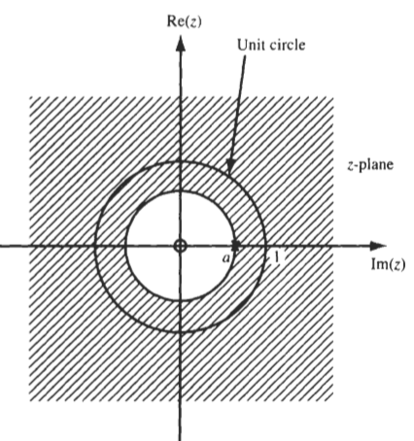
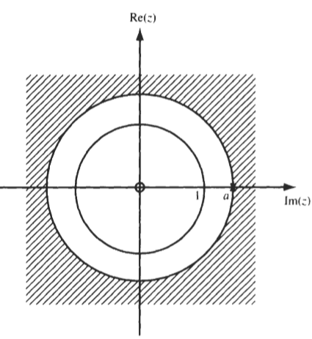
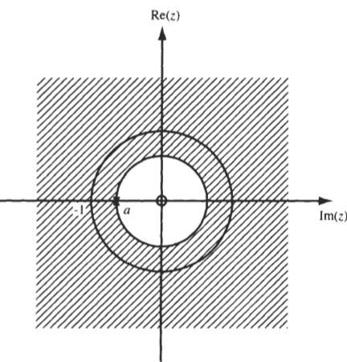
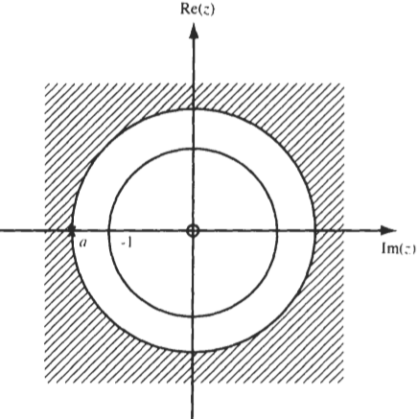
→ ROC:
0<a<1
1<a
-1<a<0
a<-1
BLG354E - İTÜ Faculty of Computer Engineering and Informatics - Üstündağ

Slide 5




Example:
Find the Z transform and ROC of the signal sequence x[n] defined as
X(z)
Every term in X(z) will be finite and consequently X(z) will converge for the z not equal to zero or infinity
BLG354E - İTÜ Faculty of Computer Engineering and Informatics - Üstündağ

Slide 6
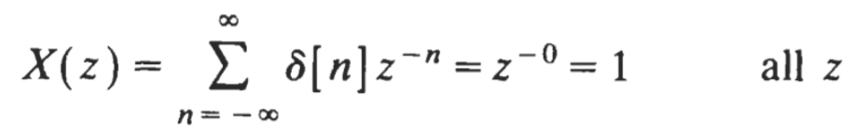
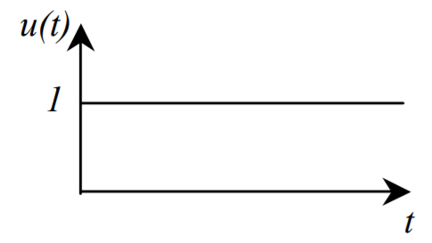
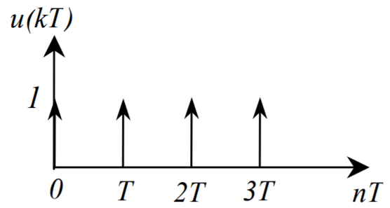
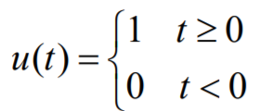

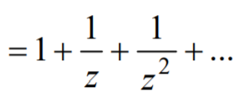
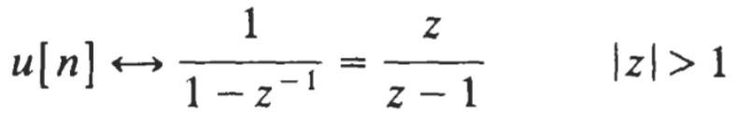
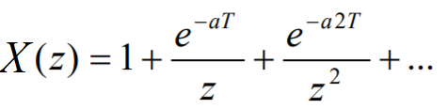

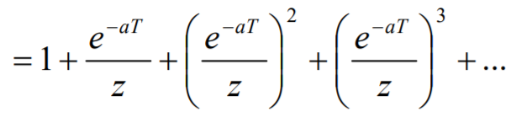


z-TRANSFORM OF SOME COMMON SEQUENCES
x[n]=δ[n]
→
x[n]=u[n]
→
X(z)
→
If x(t) is sampled at T=1/f
X(z)
↔
BLG354E - İTÜ Faculty of Computer Engineering and Informatics - Üstündağ

Slide 7


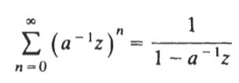



Example:
Find the z transform of x[n]=-a^{n}u[-n-1]
Hence,
for
BLG354E - İTÜ Faculty of Computer Engineering and Informatics - Üstündağ

Slide 8

Z Transform of Finite Sequence
consider the sequence of sampled numbers, x[k]
x[k]
X(z)
H(z)
Y(z)
If the system transfer function H(z) is known then the output signal can be found via inverse transform of Y(z)
where Y(z)=X(z)·H(z)
BLG354E - İTÜ Faculty of Computer Engineering and Informatics - Üstündağ

Slide 9
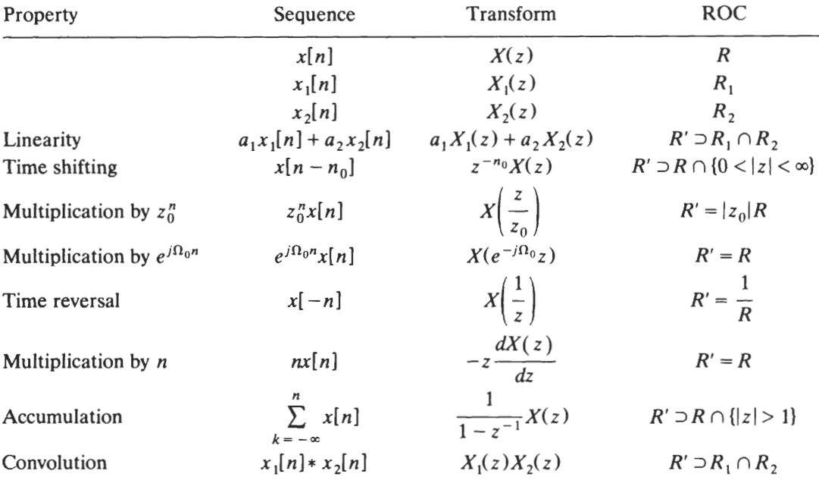
Properties of the Z Transform
BLG354E - İTÜ Faculty of Computer Engineering and Informatics - Üstündağ

Slide 10
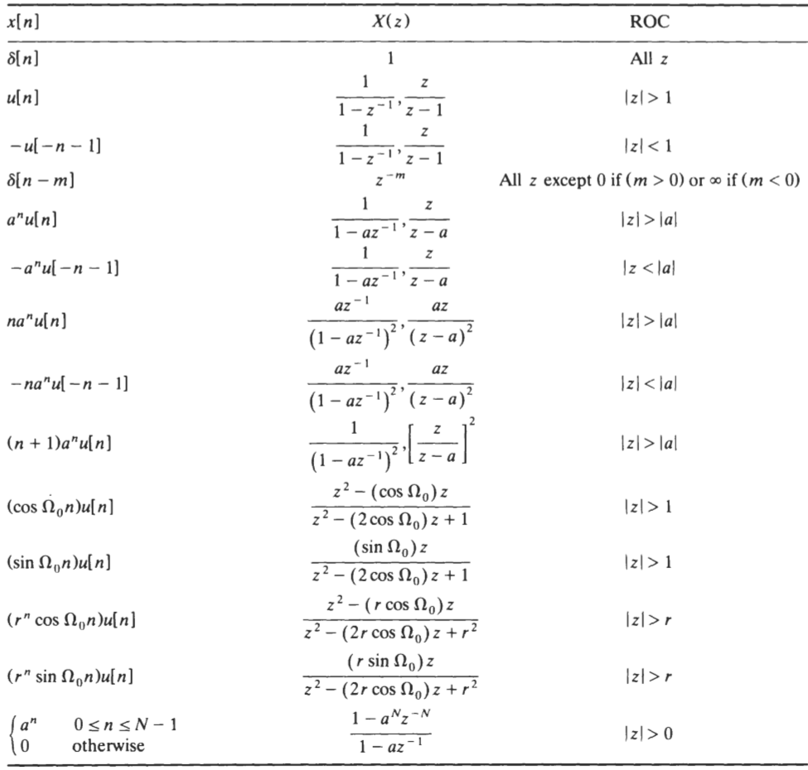
Common Z Transform Pairs
BLG354E - İTÜ Faculty of Computer Engineering and Informatics - Üstündağ

Slide 11




Inverse Z-Transform
Finding the sequence x[n] from its z-transform X(z) is called the inverse z-transform, symbolically denoted as x[n]=Z⁻¹{X(z)}
Method 1: Inversion Formula
where C is a counterclockwise contour of integration enclosing the origin
Method 2: Use of Tables of z-Transform Pairs:
X(z) is expressed as a sum
where X₁(z ), X₂(z ), . . . , X_{n}( z) are functions with known inverse transforms x₁[n], x₂[n]…, x_{n}[n]
Method 3: Power Series Expansion:
This method is useful for a finite-length sequence where X(z) may have no simpler form than a polynomial in z⁻¹
BLG354E - İTÜ Faculty of Computer Engineering and Informatics - Üstündağ

Slide 12

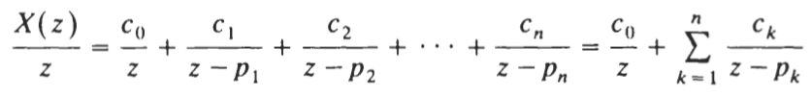


Method 4: Partial-Fraction Expansion:
Partial-fraction expansion method provides inverse z-transform, especially when X(z) is a rational function of z.
where
Hence we can inverse transform from each term separately by using the table
BLG354E - İTÜ Faculty of Computer Engineering and Informatics - Üstündağ

Slide 13
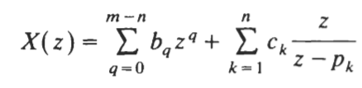
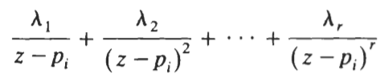
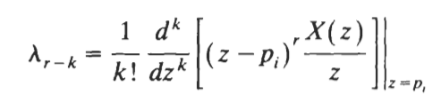
If m>n then a polynomial of z must be added to the right-hand side of the equation so that for m>n,
the complete partial-fraction expansion would have the form
If X(z) has multiple-order poles
where p_{i} is the multiple pole with multiplicity r. The expansion of X(z)/z will consist of terms of the form
BLG354E - İTÜ Faculty of Computer Engineering and Informatics - Üstündağ

Slide 14

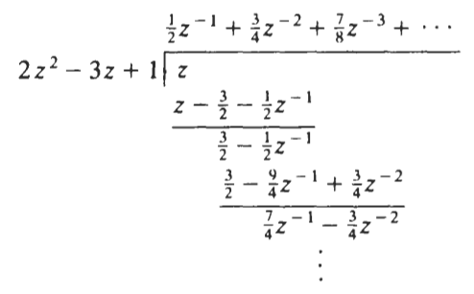


Example:
Find the inverse z-transform of the following X(z) by using the power series expansion method
ROC is lzl> 1 and x[n] is a right-sided sequence. Therefore, we must divide so as to obtain a series in power of z⁻¹ as follows
BLG354E - İTÜ Faculty of Computer Engineering and Informatics - Üstündağ

Slide 15
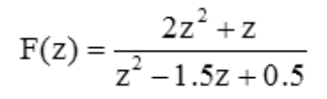
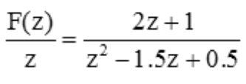
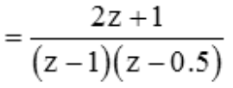


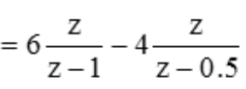


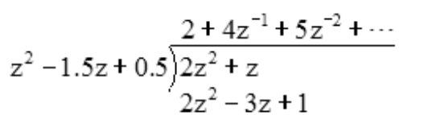



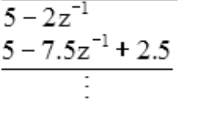
Example:
Find the inverse Z transform of
by using the table and power series methods
u[k]
0.5^{k}
f[k]
z⁻²
BLG354E - İTÜ Faculty of Computer Engineering and Informatics - Üstündağ

Slide 16











Example:
Find the inverse z transform of
By using the partial fraction expansion method:
Since the ROC of X(z) is lzl> 1, x[n] is a right-sided sequence:
BLG354E - İTÜ Faculty of Computer Engineering and Informatics - Üstündağ

Slide 17









Example:
Find the inverse z transform of
By using the partial fraction expansion method:
where
By setting z=0 we get
Since the ROC of X(z) is lzl> 2, x[n] is a right-sided sequence:
BLG354E - İTÜ Faculty of Computer Engineering and Informatics - Üstündağ

Slide 18




Convolution with z-transform
Z Transform has the convolution property in the same way as it was for the Laplace Transform.
Convolution of two signal sequences x[k] and h[k] can be stated as y[k] where,
↔
BLG354E - İTÜ Faculty of Computer Engineering and Informatics - Üstündağ

Slide 19
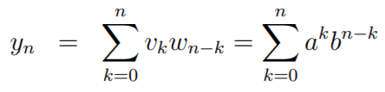


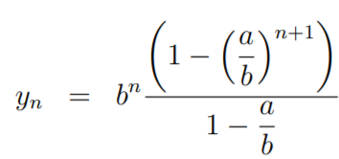




Example:
v[n]={v_{n}} = {a^{n}}
w[n]={w_{n}}= {b^{n}}
Calculate the convolution y[n] of the sequences
a≠b
→
Z transforms of v[n] and and w[n] are:
using partial fractions or residues
BLG354E - İTÜ Faculty of Computer Engineering and Informatics - Üstündağ

Slide 20
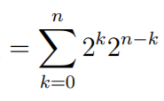
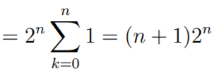




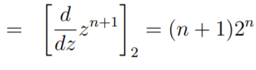
Example:
A discrete time signal sequence is given as x[n]=2^{n} (n>0). Find the convolution y[n]=x[n]*x[n]
by using the definition of the convolution
by using the Z transform
a)
x[n]={1,2,4,8,…}
y[n]
b) Z transform of x[n] :
X(z)=Z{2^{n}}
→ y[n]=Z⁻¹
Y(z) has a second order pole at z=2. If we use the residue method then we get,
y[n]=
BLG354E - İTÜ Faculty of Computer Engineering and Informatics - Üstündağ

Slide 21




Example:
Z transform can also be used for solving the difference equations
For example,
BLG354E - İTÜ Faculty of Computer Engineering and Informatics - Üstündağ

Slide 22
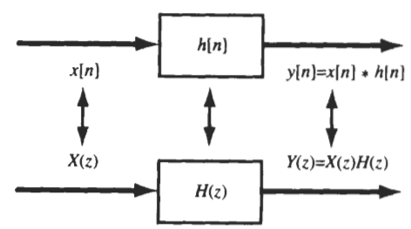



TRANSFER FUNCTION OF DISCRETE-TIME LTI SYSTEMS
Z-Transform
Z-Transform
Z-Transform
Output y[n] of a discrete-time LTI system equals the convolution of the input x[n] with the impulse response h[n]
BLG354E - İTÜ Faculty of Computer Engineering and Informatics - Üstündağ

Slide 23
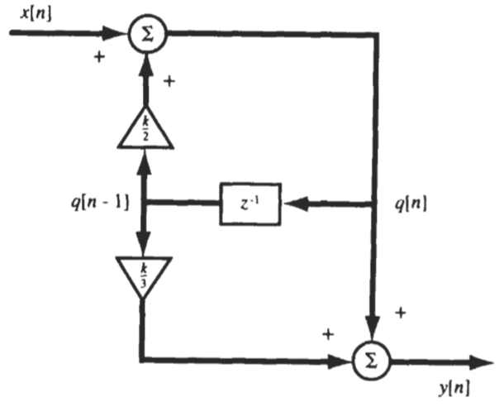
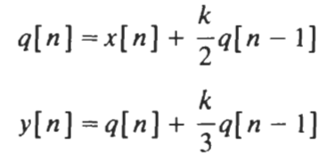
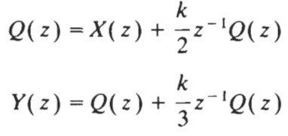
Example:
Find the k values that makes the system shown in the figure BIBO stable.
→
BLG354E - İTÜ Faculty of Computer Engineering and Informatics - Üstündağ

Slide 24
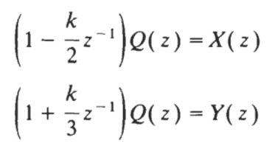
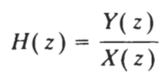

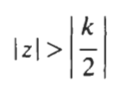

The system has one zero at z = -k/3 and one pole at z = k/2 → ROC is lzl> lk/2l
Therefore system will be BIB0 stable if the ROC contains the unit circle, lzl= 1
→ the system is stable only if IkI<2

Slide 25
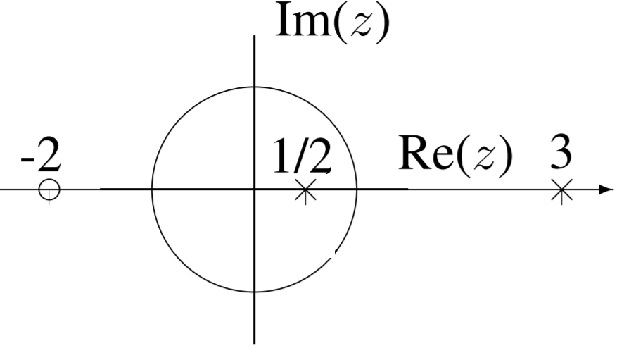
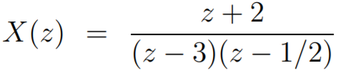
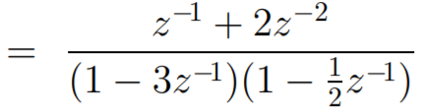


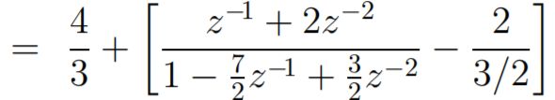
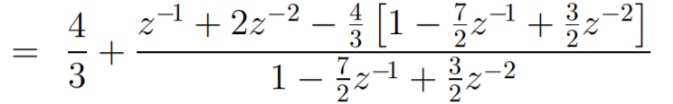
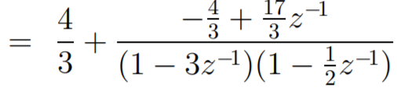
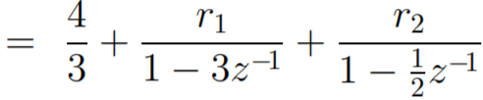
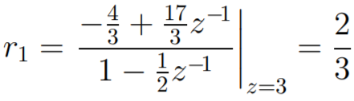
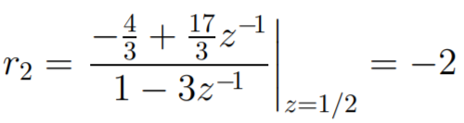
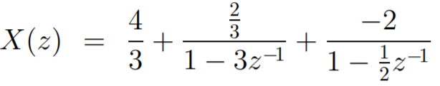
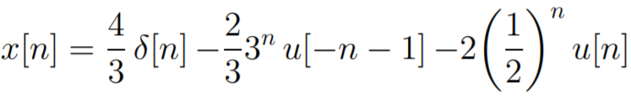
Example:
z-transform of the signal X(z) has the pole-zero plot shown below. Find the DT signal x[n]
+J
-1
+1
→
-J
(Partial Fraction Expansion)
→
anti-casual
BLG354E - İTÜ Faculty of Computer Engineering and Informatics - Üstündağ

Slide 26
